Slide 1
Image Caption Generator
DATA 606 Final Project Presentation
Sravya Pamula (DP51938)
Hema Kavuri(MP61613)

Slide 2
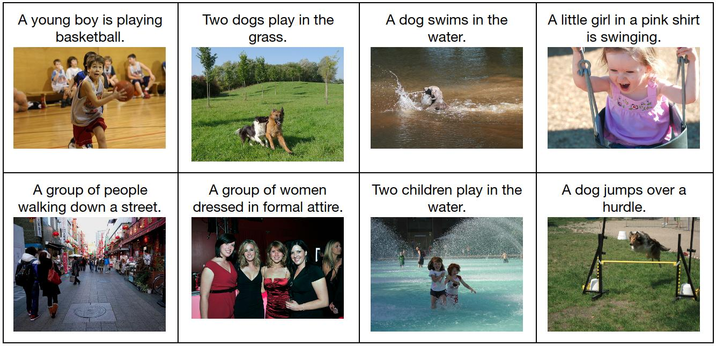
Introduction
An image caption generator descriptions what is going on an image
Can a machine do this? Using tools such as natural language processing and object detection (computer vision), it is possible to train a model to do this task
Image caption generator bears applications in assistive technology and can help visually impaired to infer their surroundings. It can also be extended to uses such as map descriptions for users/self-driven cars

Slide 3
Objective
The primary goal of this project is to build an image caption generator using PyTorch library. The result would be a model that can generate a caption for a given image. Deep learning and NLP ideas are used to achieve this.

Slide 4
Data Source
The dataset that will be used for this is the Flickr8k which can be found here: https://www.kaggle.com/datasets/e1cd22253a9b23b073794872bf565648ddbe4f17e7fa9e74766ad3707141adeb
This dataset consists of about 8000 image files and captions for the same.
Dataset Consist of
(i) Images Folder – all images are in JPG format.
(ii) Captions – CSV file.
Apart from these we also have a test example dataset with 8 images for which captions need to be generated.

Slide 5
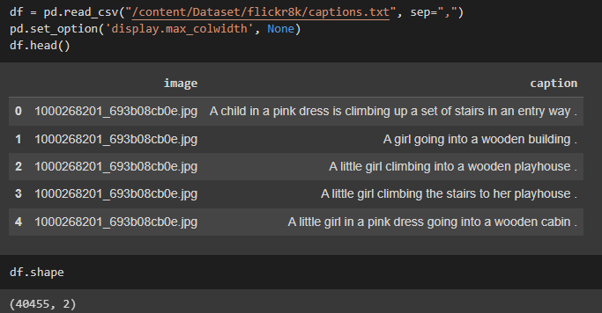
Exploratory Data Analysis
Data is stored in and retrieved from Google Drive because of its huge size
In order to load the data, we need to mount our drive to notebook
The Size of the Captions file is 40455

Slide 6
Preprocessing
Vocabulary Class:
Tokens are created for words that occur more than the threshold frequency
stoi and itos dictionaries created to switch from string to index for these tokens
Pad token, start of sentence, end of sentence and unknown are defined
FlickrDataset Class:
Define dataset attributes such as root directory, captions file, etc.
Retrieve the image and caption from the dataset and numericalize it
Returns a PyTorch Tensor

Slide 7
3. MyCollate Class:
Converts all the images into the same dimensions for modeling
Pads the target captions to the same length for modeling
4. GetLoader Class:
Defines a FlickrDataset class object
Uses the inbuilt PyTorch DataLoader to get the data ready for modeling in PyTorch

Slide 8
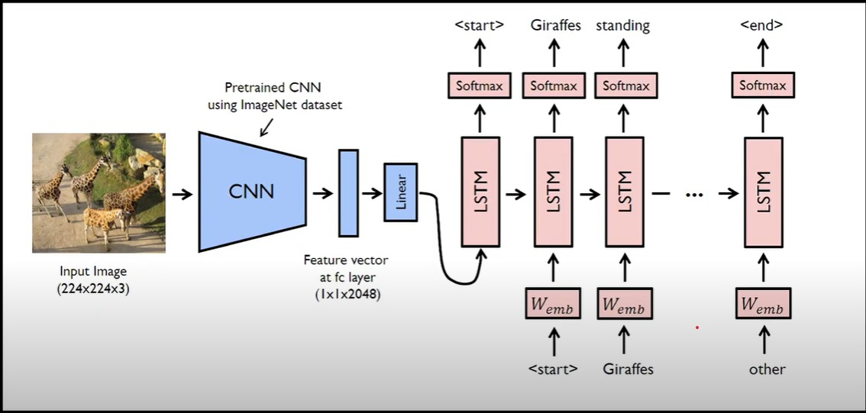
Modeling

Slide 9
EncoderCNN:
Encodes the information in the images using a Convolutional Neural Network
Pretrained inceptionV3 model in PyTorch is used
Last Fully Connected (Linear) layer of the pretrained model is modified to return a tensor of the size that goes into the RNN (LSTM)
DecoderRNN:
LSTM is the most used RNN for natural language processing
LSTM retains context/information in long-term memory along with the short-term memory from the previous time step
LSTM takes in output from the encoder CNN and uses it along with Vocabulary to generate captions based on context

Slide 10
3. CNNtoRNN Class:
Combines both the EncoderCNN and DecoderRNN models
Words of the caption are generated one by one. The initial input is the output of the EncoderCNN which is used to generate the first word of the caption.
This word is sent to the DecoderRNN again and is used to generate the next words.

Slide 11
Training
CNNtoRNN model is used for training
Training is done using batch processing with a batch size of 32. Maximum number of epochs used for training are 30.
Images and captions are sent to the model and outputs are used to calculate loss/ CrossEntropyLoss from PyTorch is used for this.
Adam optimizer is used to optimize the training process.

Slide 12
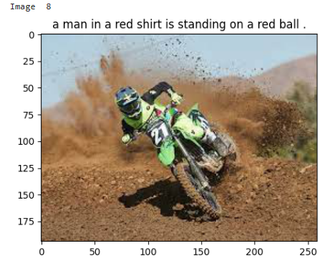
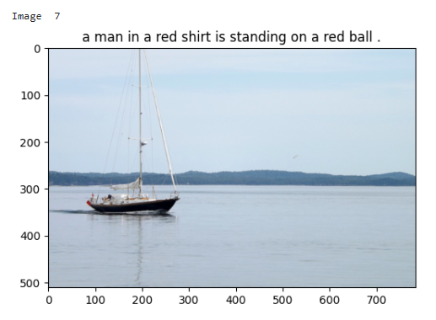
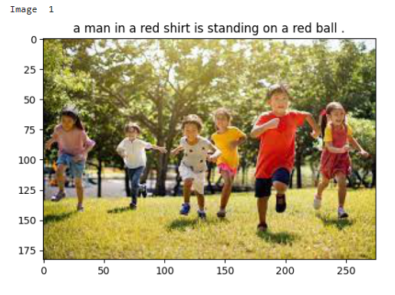
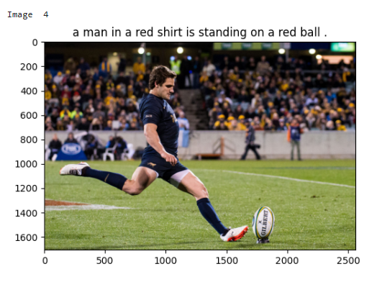
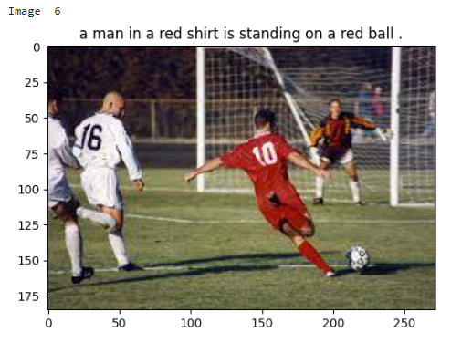
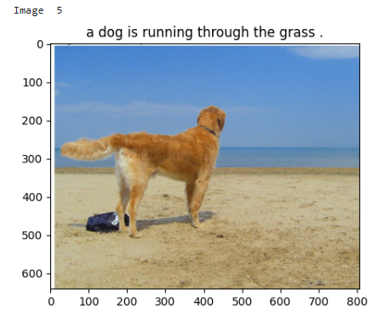
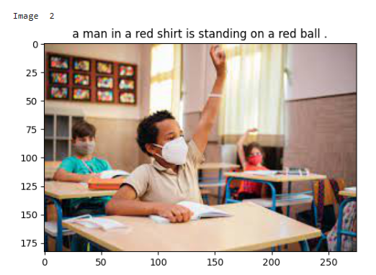
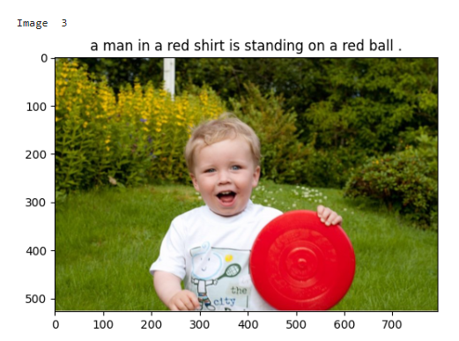
Results 1 Epoch

Slide 13
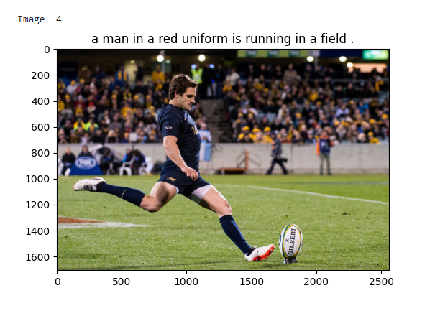
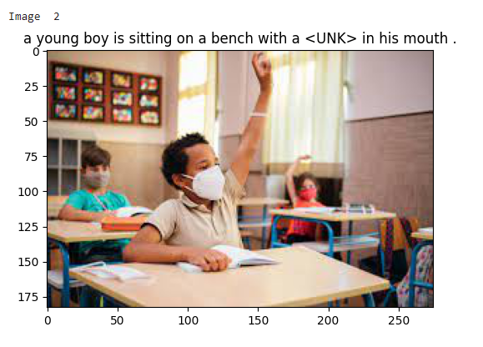
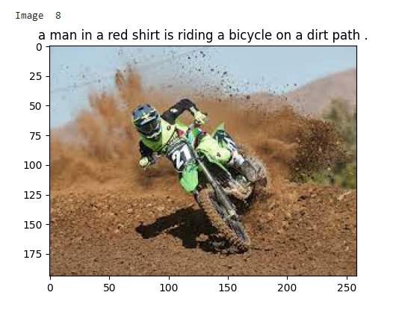
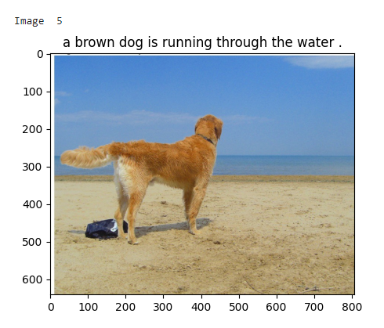
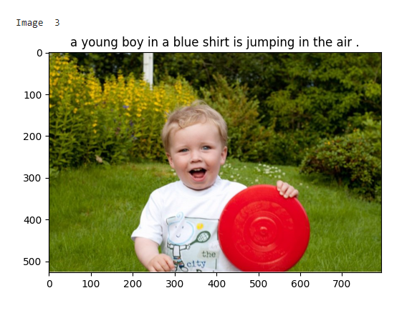
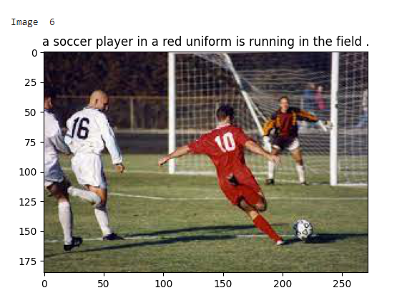
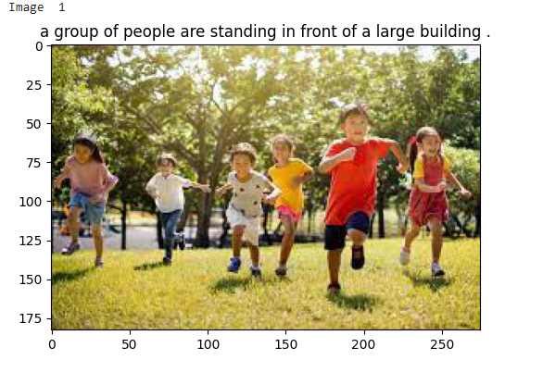
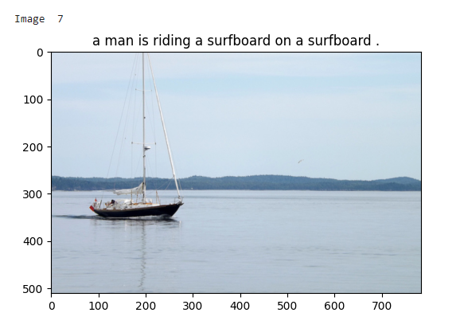
10 Epochs

Slide 14
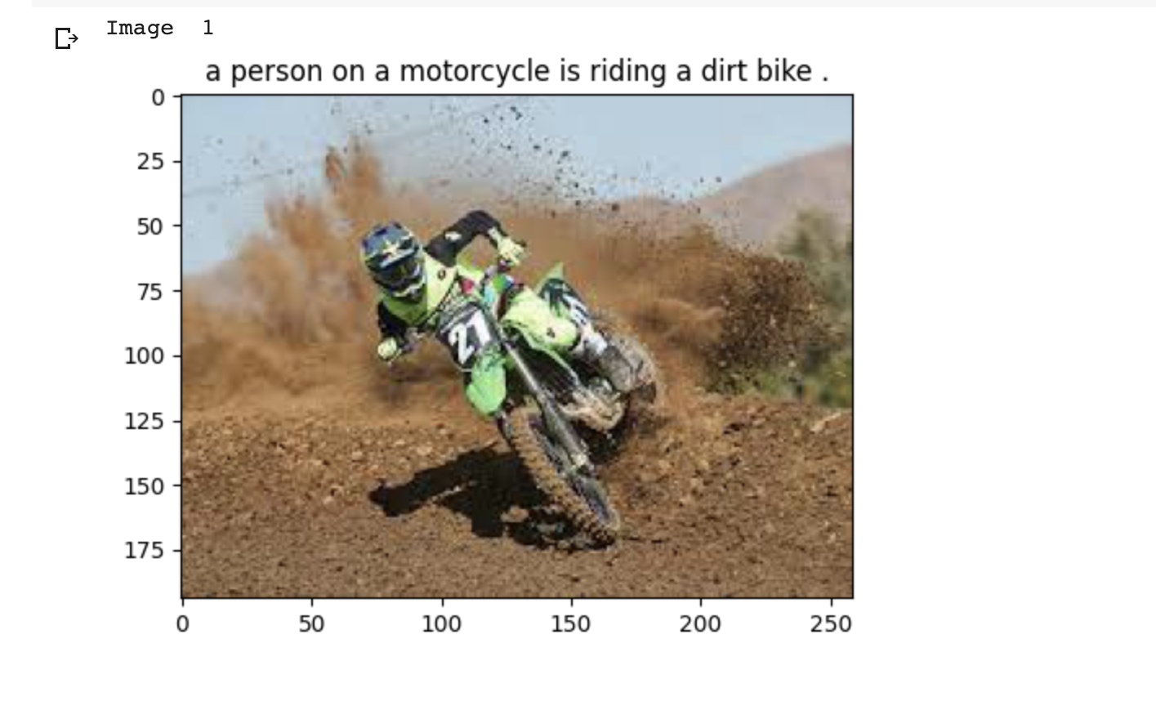
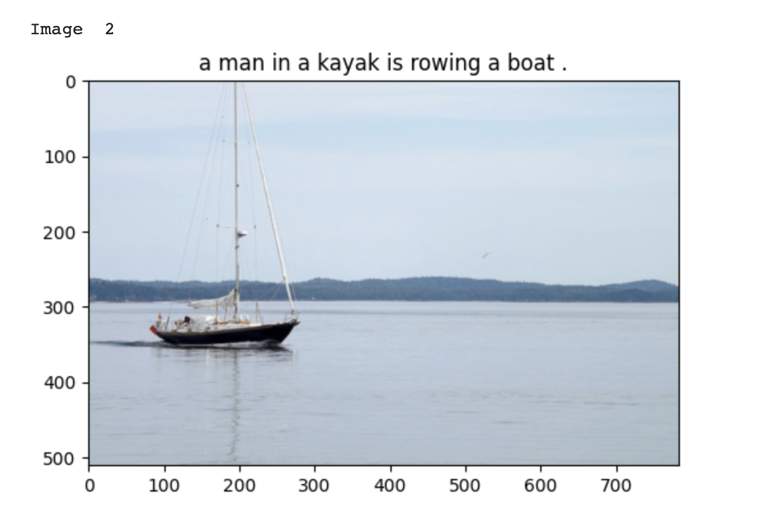
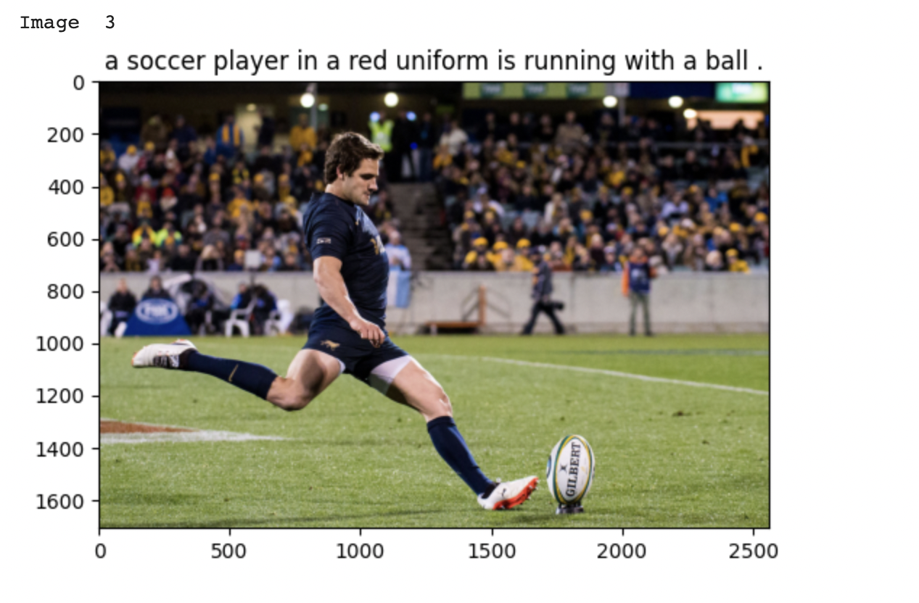
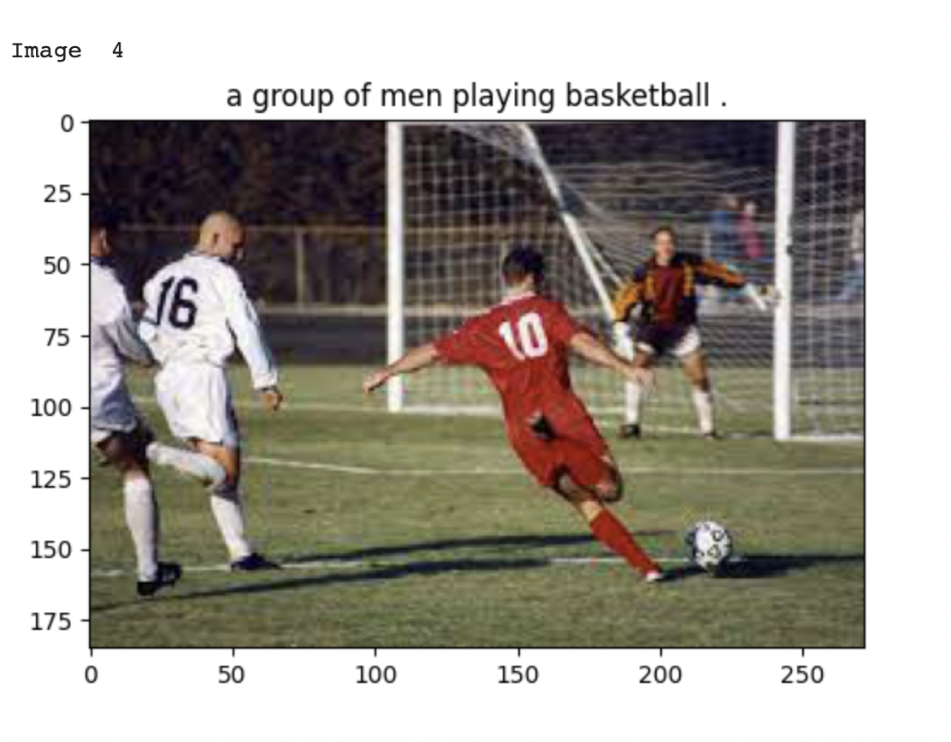
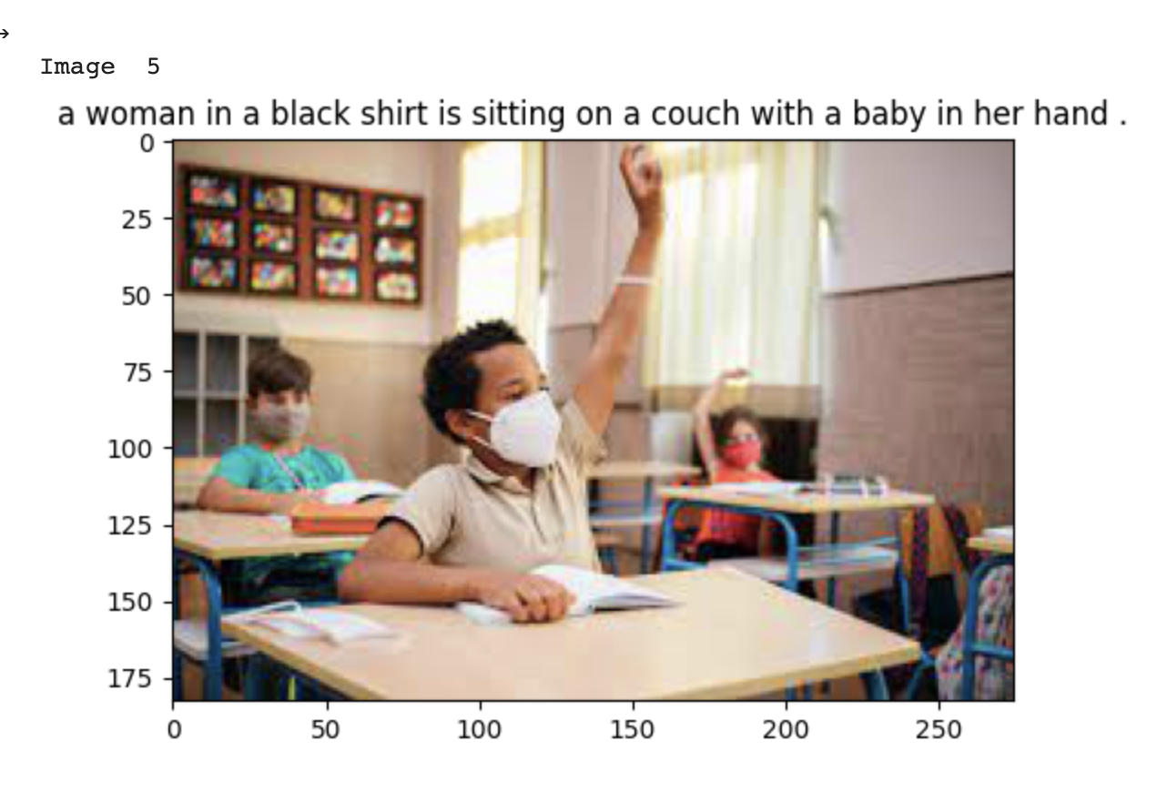
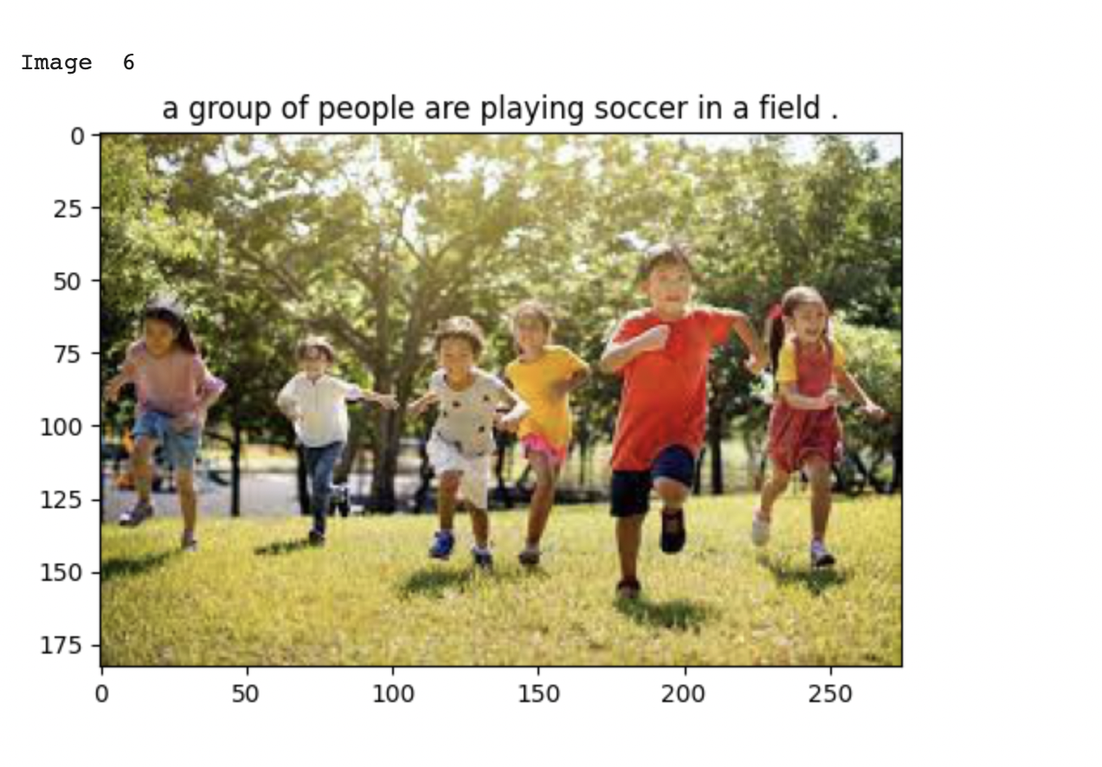
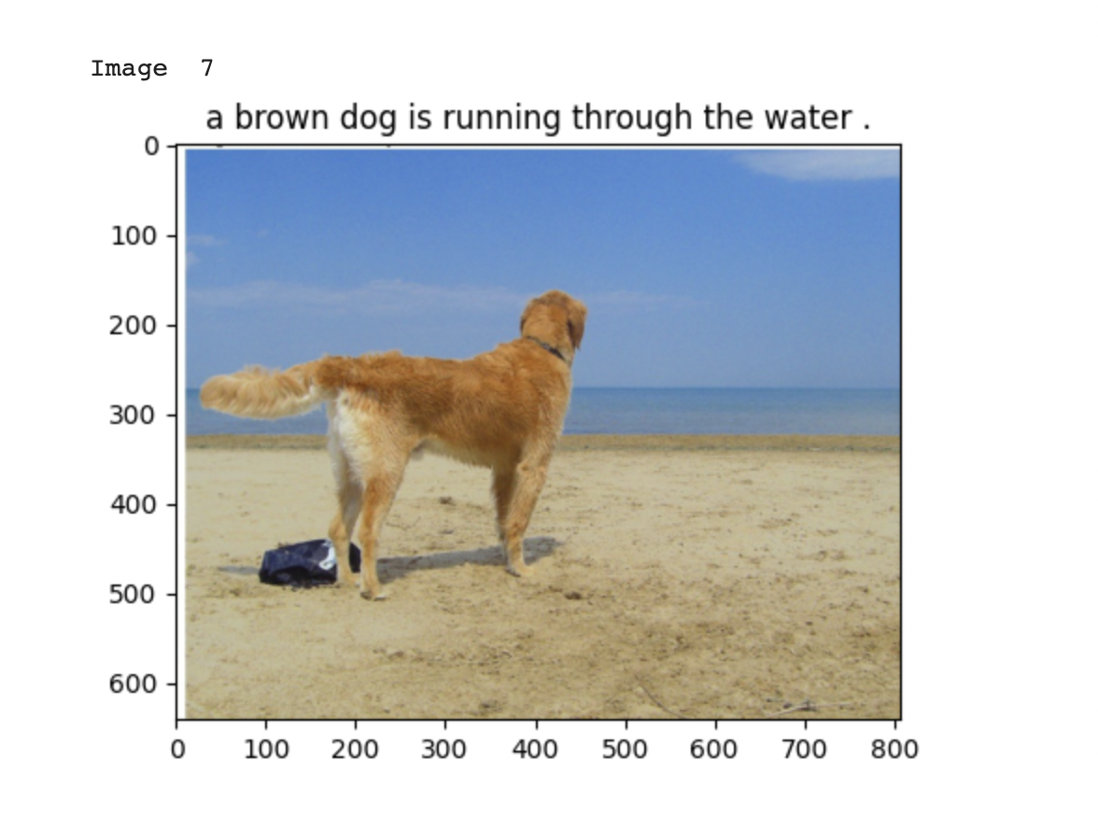
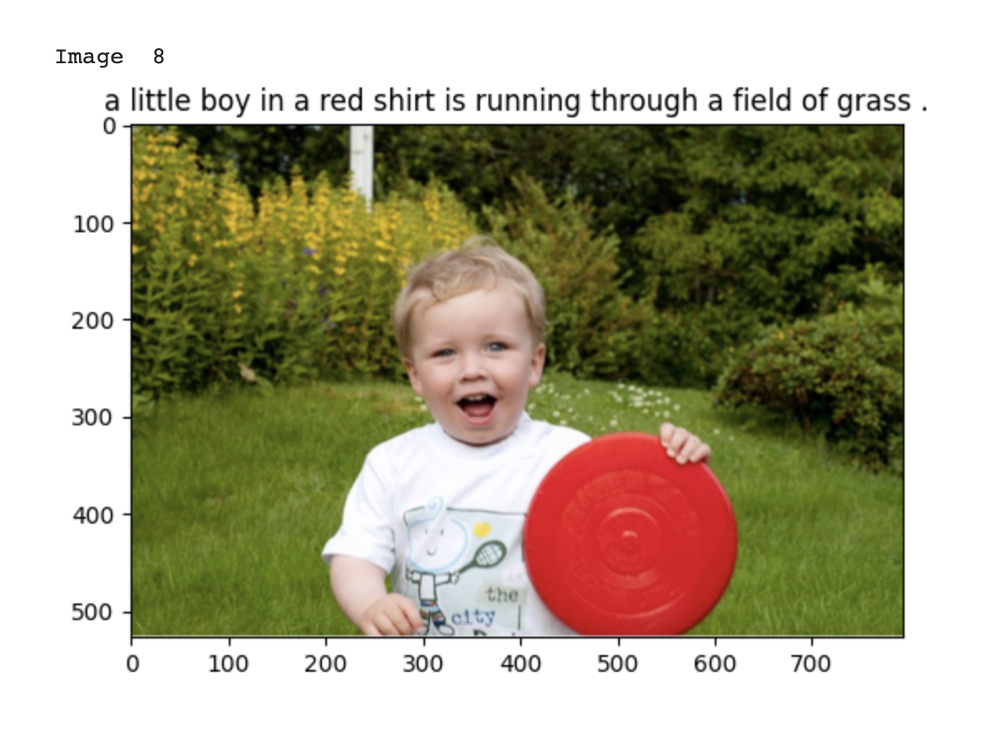
30 Epochs

Slide 15
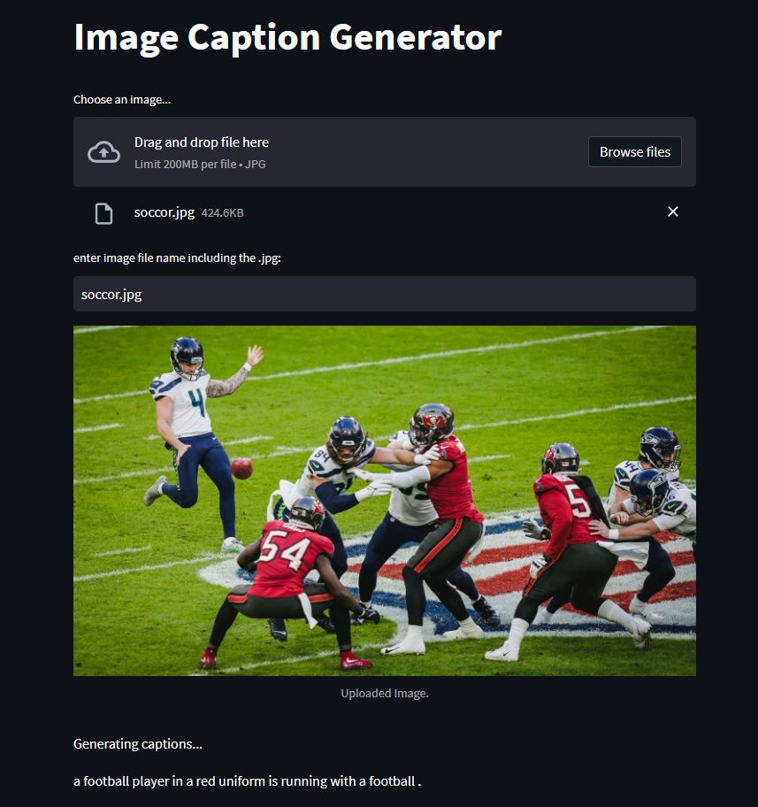
Streamlit
Simple web application using streamlit developed
App takes in an image from the user
App returns a caption for the image as generated by the deep learning model

Slide 16
Future Work
To improve its accuracy, we can try by increasing number of epochs to 50, 100 with help of more powerful computational resources
We can try using different CNN models like AlexNet and LeNet inplace of InceptionV3 to encode the image
Tweaking the hyper-parameters can give better performance of the model
Using a different/more diversified dataset can help the model learn better

Slide 17
Challenges/Lessons
The biggest challenge we faced is runtime as it takes more than 4 hours to run 1 epoch using CPU
To overcome this, we used GPU to train the model, runtime reduced to 10-15 mins to run 1 epoch, limited GPU
Got exposed to fundamentals of Deep learning, NLP and PyTorch library

Slide 18
References
https://arxiv.org/pdf/1502.03044.pdf
https://www.youtube.com/watch?v=y2BaTt1fxJU&ab_channel=AladdinPersson
https://www.youtube.com/watch?v=9sHcLvVXsns&ab_channel=AladdinPersson
https://github.com/Siddharth1698/Image-Captioning-with-Inception-LSTM/blob/main/model.py

Slide 19
Thank You

